Slide 1

Dynamic Graphs: Predicting Future Bigrams in Patents with NLP and LP
Atul Kumar
Supervisor: Dr. Zamilur Rahman

Slide 2

Insights from our Last Project
Social Networks can be represented as graphs, where users are represented as the graph nodes and the relationship between those nodes as an edge.
Graph theory concepts can be applied to forecast the appearance /disappearance of links between the nodes.
Similarity scores can be calculated to predict future links.
Apart from Social Networks, link prediction has several applications in other fields.

Slide 3
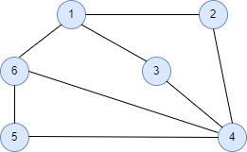

Graph Overview
A graph G consists of two sets: a set of vertices, or simply nodes, and a set E of edges that connect the vertices.
$$V=\left\{1,2,3,4,5,6\right\}$$
$$E=\{(1,2), (1,3), (1,6), (2,3), (2,4),………\}$$
There are different types of graph:
Directed Weighted Graph
Directed Unweighted Graph
Undirected Weighted Graph
Undirected Unweighted Graph

Slide 4
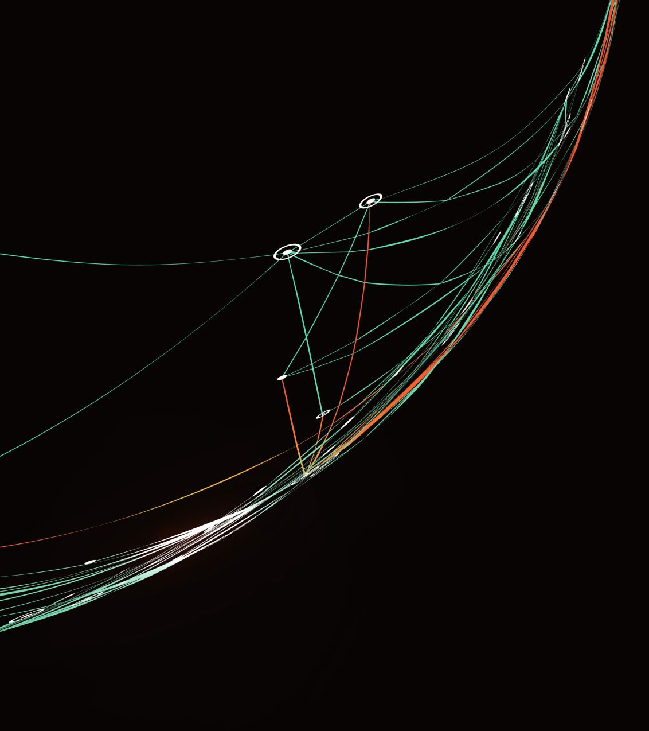
What is a Dynamic Graph?
Opposites of static, it evolves over time.
Contains a series of snapshots.
Each snapshot contains the network information captured at a specific point in time.
Changes are tracked down at each snapshot.
By analyzing given networks, it makes predictions about future connections.

Slide 5

What is NLP and LP?
NLP:
NLP stands for Natural Language Processing.
Allows processing datasets which contain languages like English.
Involves tasks to transform the data into an appropriate form.
Some common tasks are tokenization and lemmatization of words

Slide 6
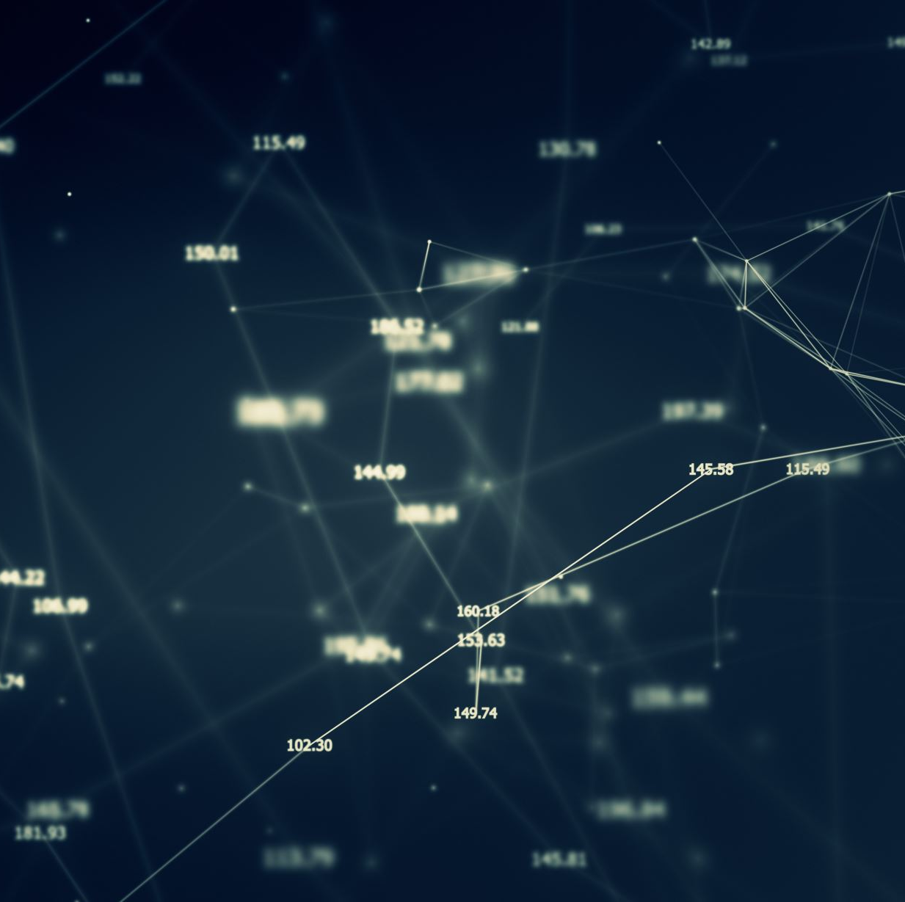
What is NLP and LP?
LP:
LP stands for Link Prediction
Predicting the link (or edge) between the nodes.
Calculate similarity scores between two nodes, and predict how likely will there be an edge or not.
Existing or non-existing links are used to calculate similarity scores.

Slide 7
Datasets
Chosen three different years’ patents as the source data.
Patents have been extracted from the USPTO.
Selected only three sections of patent to avoid information overflow i.e. Title, Abstract, and Claims.
Prepared to recognize the text i.e. pdf -> gdoc -> docx -> txt
We chose the Medical field to predict future bigrams using the following query:
(MEDICAL ADJ APPARATUS OR Pharmaceuticals OR MEDICAL WITH DEVICES OR Healthcare AND Informatics OR Medical ADJ Imaging) AND @ay>="2017" AND @py<="2019"

Slide 8
Motivation behind choosing Patents
Rich and diverse content about technological changes and advancements.
Domain-specific vocabulary.
Well structured, makes it easier to extract specifics.
Predicted bigrams might open the doors for new research areas.

Slide 9
Tasks Performed Under NLP
Numeric and Punctuation
Special Characters
Stopwords
Tokenization
Lemmatization
Repetitive Words

Slide 10

Key Terms:
Unigrams: a single word or token.
Bigrams: a pair of words.
Term Frequency (TF): the number of times the particular words appear.
Inverse Document Frequency (IDF): represents the uniqueness of the term:
$$\log\left(\frac{number of patents}{number of patents containing this term}\right)$$
Term Frequency-Inverse Document Frequency(TF-IDF): reflects the importance of word in a document, can be achieved by multiplying TF & IDF together.

Slide 11
Graph Construction
Graphs consist of nodes and edges.
Top 600 tokenized words (unigrams) having high tf-idf values are considered nodes.
A pair of words are bigrams if they are separated by no more than 2 unigrams.
E.g. [a, b, c, d, e]
If they are bigrams, there exists a link between a pair of words.
Bigrams can’t have both of the same words, to avoid loops.

Slide 12
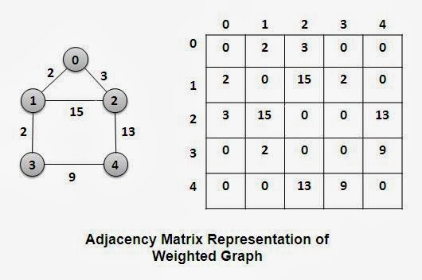
Graph Construction (Contd.)
Pair of words are bigram if they have co-occurred together.
Kept the unigrams static for each year, but edges can be different (dynamic).
Frequency of the same words co-occurred together determines the edge weight.
Used adjacency matrix to construct graphs.
Source: Graphs and Trees (mtsu.edu)

Slide 13
Word2vec Embedding
Popular word embedding technique for NLP tasks
Tokens are represented as vectors and calculate the semantic relationship between words.
Trained Word2vec model on each time period patents separately.
Generated all possible bigrams (connected or not)
Calculated the cosine similarity score between bigram’s pairs of words for each year.

Slide 14
Similarity Coefficients
Common Neighbours
Adamic Adar
Jaccard
Preferential Attachment
SimRank
RootedPageRank
Katz
Resource Allocation

Slide 15
Similarity Coefficients (Contd.)
For year 2017 & 2018:
Calculated all aforementioned similarity coefficients.
Included the TF, TF-IDF, and cosine similarity scores.
Lastly, a column is added showing the status of whether a link persists for next year’s data or not.
The above steps performed separately for nodes having edges and nodes that don’t have them.

Slide 16
Similarity Coefficients (Contd.)
For last year’s patents:
Again calculated all similarity coefficients.
Included TF, TF-IDF, and cosine similarity between bigrams.
Separately calculated them for the nodes having edges and nodes that don’t have them.
However, there won’t be any column to record the next year’s links that persist.
Training this data on the ML models helps us predict them.

Slide 17
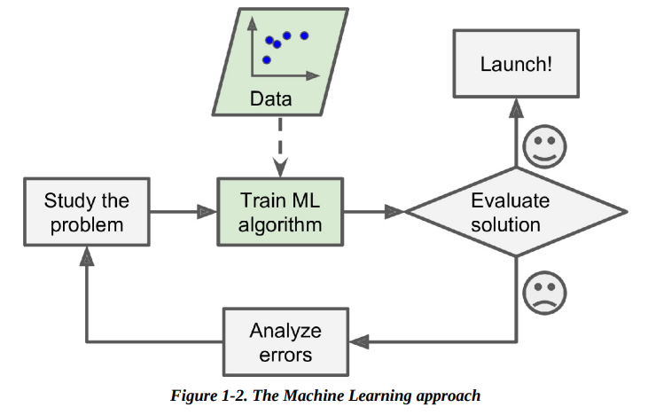
ML Algorithmic Approach
ML models are one of the key methods for link prediction.
Involves passing the training data to the model, so it can learn and test the unseen data.
Implemented several ML models involving a deep neural networks models.
All trained using supervised learning technique.
Source: Geron A.(2019). Hands-On Machine Learning with Scikit-Learn, Keras & TensorFlow. [The Machine Learning approach].ch.1

Slide 18
ML Models
Since this is a classification task, here are the model classifiers:
Logistic Regression
Decision Tree
Extra Trees
Random Forest
Stochastic Gradient Descent
XGBoost
Voting
Multilayer Perceptron (MLP)
Long Short-Term Memory (LSTM)
Bidirectional Long Short Term Memory (Bi-LSTM)

Slide 19

Train and Test Data
Used 2017 and 2018 patents to find out the best model.
Combined and normalized data for existing and non-existing links between nodes.
Next year’s edge status will work as labels.
Lastly, we split the data into a ratio of 80:20 to train and test our models.

Slide 20

Train and Test Data (Contd.)
After running, the XGBoost model was found to work best.
Used this model to predict future bigrams.
Combined and normalized both the existing and non-existing links scores for last year’s datasets.
Passed this data to the best-performing model and predicted the bigrams for the next year.

Slide 21
Extracting Future Bigrams
From the adjacency (co-occurrence) matrices, the edge status column was extracted, for the first two years.
We also had a list of possible bigrams.
Everything was merged, which shows the link(edge) status for all three years.
Next year’s predicted edge values then merged
Run the query to extract the future bigrams.

Slide 22
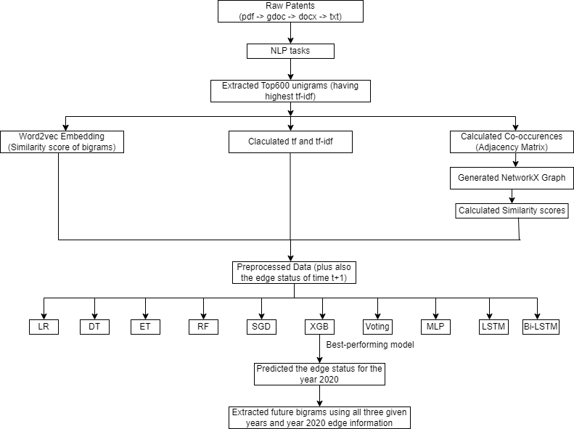
Graphical Representation of Approach

Slide 23
Experimental Results
Classifiers | Patents Dataset
 | TRAINING SET RESULTS |  |  |  | TEST SET RESULTS
 | Accuracy | Precision | Recall | F1_Score | Accuracy | Precision | Recall | F1_Score
LR | 91.93% | 98.87% | 92.75% | 95.71% | 91.94% | 98.88% | 92.75% | 95.72%
DT | 86.94% | 100.00% | 100.00% | 100.00% | 86.84% | 92.33% | 93.17% | 92.75%
ET | 91.83% | 100.00% | 100.00% | 100.00% | 91.88% | 98.77% | 92.78% | 95.68%
RF | 91.89% | 100.00% | 100.00% | 100.00% | 91.90% | 98.80% | 92.78% | 95.70%
SGD | 91.77% | 99.62% | 92.02% | 95.67% | 91.84% | 99.63% | 92.06% | 95.70%
XGB | 92.01% | 99.03% | 92.82% | 95.82% | 92.07% | 98.97% | 92.81% | 95.79%
Voting | 93.23% | 100.00% | 93.07% | 96.41% | 92.00% | 99.22% | 92.54% | 95.76%
MLP | 92.01% | 98.67% | 92.99% | 95.75% | 91.99% | 98.67% | 92.97% | 95.74%
LSTM | 91.79% | 99.57% | 92.07% | 95.67% | 91.84% | 99.57% | 92.11% | 95.70%
Bi-LSTM | 91.98% | 99.17% | 92.55% | 95.75% | 91.99% | 99.17% | 92.57% | 95.76%

Slide 24
Discussion
All the models are performing well enough achieving an accuracy of 90% except the decision tree with a bit low accuracy.
None of the models are overfitting the training data, achieving almost the same accuracies on the test and training set.
The Voting Classifier achieved the highest accuracy on the training set, but XGBoost is considered to be the best-performing model due to the highest accuracy on the test set.

Slide 25
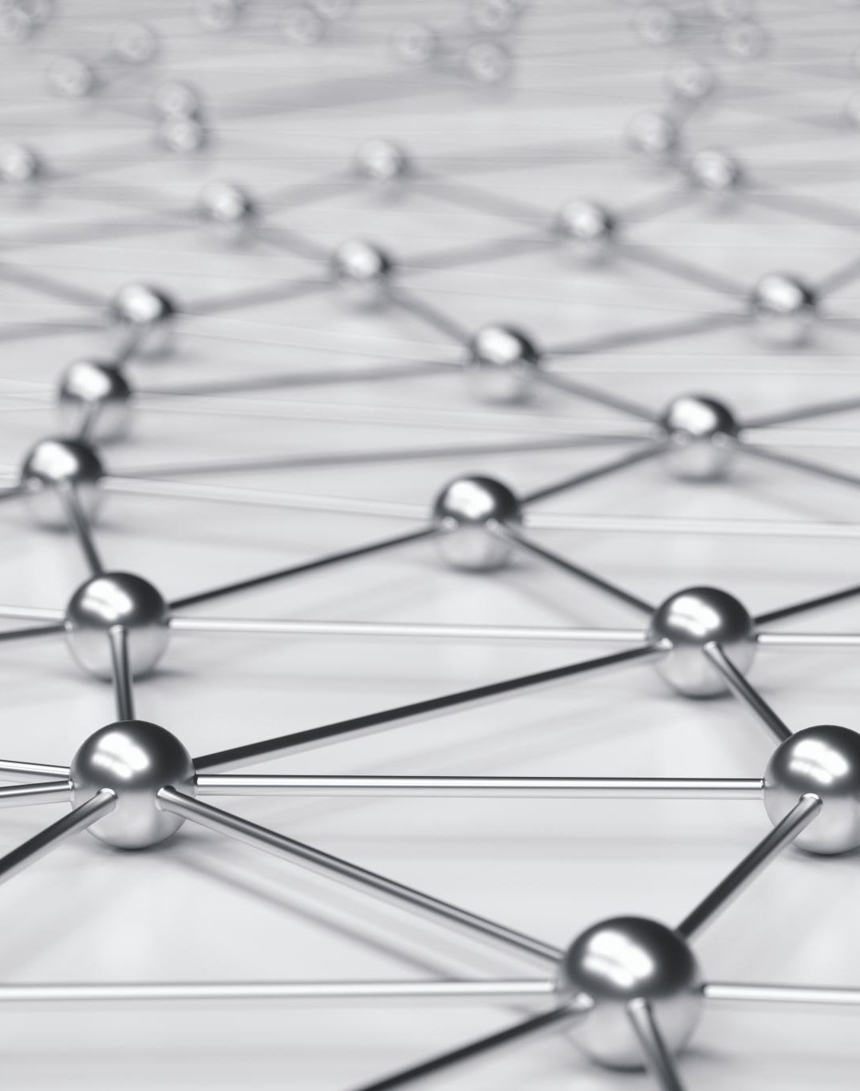
Conclusion
Models were successfully able to predict future bigrams with a high accuracy score.
This can be used to understand technological trends and future research areas.
Future work could investigate running the same model on different domains or with even more large datasets.

Slide 26
References
Patent’s website: Patent Public Search | USPTO
Wikimedia Foundation. (2023, September 5). Word2vec. Wikipedia. https://en.wikipedia.org/wiki/Word2vec
Geron A.(2019). Hands-On Machine Learning with Scikit-Learn, Keras & TensorFlow. [The Machine Learning approach].ch.1
Computer representation of graphs. Graphs and Trees. (n.d.). https://www.cs.mtsu.edu/~xyang/3080/adjacencyMatrix.html

Slide 27

Thank you

Slide 28
Tasks Performed Under NLP
Following NLP tasks applied to all patents:
Numeric and Punctuation: Eliminated words containing numbers or surrounded by them and removed the punctuations from the text like commas, colons, dots, etc.
Special Characters: Characters such as asterisks, ampersands, etc., were also removed.
Stopwords: Eliminated the stopwords such as “and”, “is”, “were”, etc. to avoid the model running on meaningless content.
Tokenization: To analyze the content further, we have broken down the sentences into words and appended them to the list.
Lemmatization: Removed the words that have the same root meaning but different forms. For example, [Chances, Chance]
Repetitive Words: There were also some other words removed which were repeated a lot of times such as “claims”, “according”, etc.

Slide 29
ML Models
Since this is a classification task, here are the model classifiers:
Logistic Regression: Computes a weighted sum of input features.
Decision Tree: Create tree where internal nodes represent input features and leaf node represents predicted outcome
Extra Trees: Choose a random split among the pool of splits
Random Forest: Combination of Decision Trees
Stochastic Gradient Descent: Handle large datasets very efficiently.
XGBoost: Finds complex relationships in data and achieves higher accuracy in predictive tasks.
Voting: Combination of the above models to create a more stable model.
Multilayer Perceptron (MLP): Computes a weighted sum of inputs and applies step function to get output.
Long Short-Term Memory (LSTM): Store information for a long time
Bidirectional Long Short-Term Memory (Bi-LSTM): Same as LSTM, propagates in both direction.

Slide 30

Similarity Coefficients
Jaccard Coefficient: It calculates the number of common neighbours between two nodes with respect to the neighbours they both have in total.
𝑱𝑪(𝒖,𝒗)= (| 𝛤(𝒖) ∩ 𝛤(𝒗)|)/(| 𝛤(𝒖) ∪ 𝛤(𝒗)|)
2) Common Neighbour: It calculates the number of common neighbours between two nodes.
𝑪𝑵(𝒖,𝒗)=| 𝛤(𝒖) ∩ 𝛤(𝒗)|
3) Preferential Attachment Score: The node will be having a high chance to connect to that node which will be having high degree compared to nodes having a lower degree.
$$PA\left(u,v\right)=\left| Γ\left(u\right)\right|.| Γ\left(v\right)|$$
4) Adamic-Adar Coefficient: High score will be assigned to the node whose common neighbours will be having less degrees, as it will be shared by fewer nodes in the network and will be more specific in that context.
$$AA\left(u,v\right)= \sum_{z∈Γ\left(u\right) ∩ Γ\left(v\right)}{\frac{1}{log|Γ\left(z\right)|}}$$

Slide 31
Similarity Coefficients
Katz Index: This metric calculates the number of all the paths from node u to v, and gives more weight to the path that has a shorter length relative to other paths from u to v.
𝑲𝒂𝒕𝒛(𝒖,𝒗)=∑_(𝒍=𝟏)^∞▒〖𝜷^𝒍∙|〖𝒑𝒂𝒕𝒉〗_(𝒖,𝒗)^𝒍 |=𝜷𝑨+𝜷^𝟐 𝑨^𝟐+𝜷^𝟑 𝑨^𝟑+…〗
Where, l is path length
𝜷 is damping factor
|〖𝒑𝒂𝒕𝒉〗_(𝒖,𝒗)^𝒍 | is the set of all paths from u to v

Slide 32
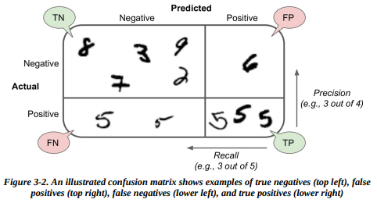

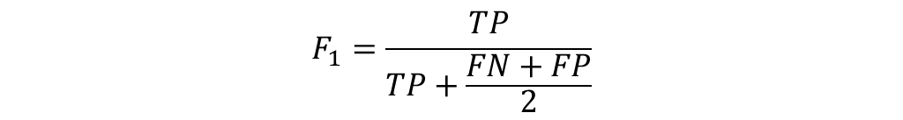
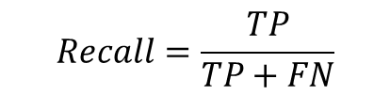
CONFUSION MATRIX
$$Precision=\frac{TP}{TP+FP}$$
$$Recall=\frac{TP}{TP+FN}$$
$$F_{1}=\frac{TP}{TP+\frac{FN+FP}{2}}$$
Source: Geron A.(2019). Hands-On Machine Learning with Scikit-Learn, Keras & TensorFlow. [The Machine Learning approach].ch.3

